Slide 1
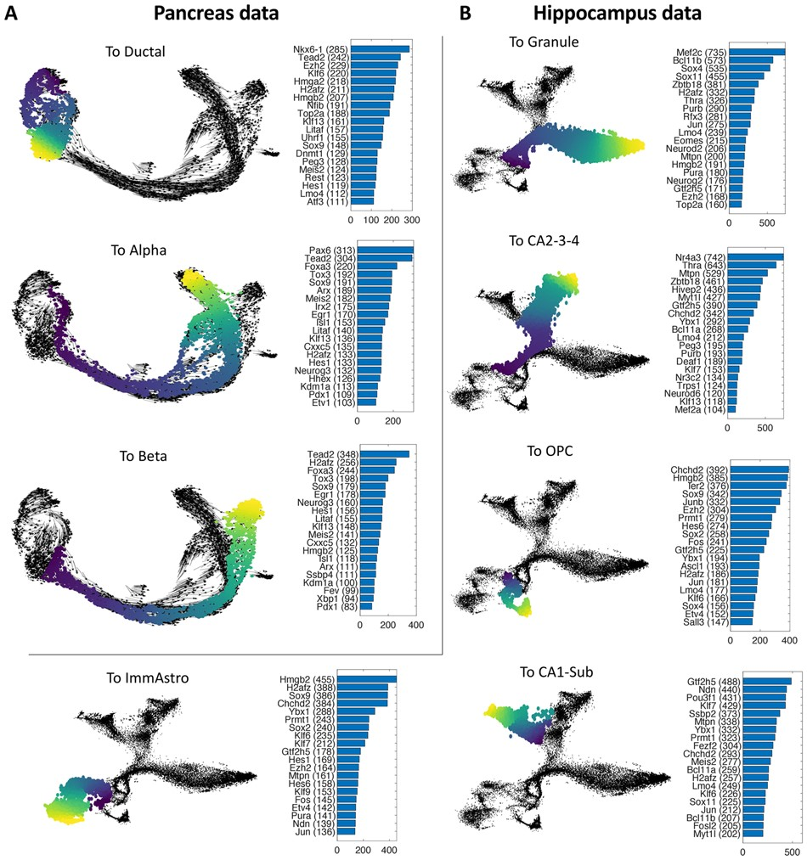

Fig. 3. Key regulators for each trajectory identified by VeTra. (A) The key regulators identified from the ...
Notes:
Fig. 3. Key regulators for each trajectory identified by VeTra. (A) The key regulators identified from the trajectories for ductal, alpha and beta cell development. (B) The key regulators identified from the five developmental trajectories in mouse hippocampus
Unless provided in the caption above, the following copyright applies to the content of this slide: © The Author(s) 2021. Published by Oxford University Press.This is an Open Access article distributed under the terms of the Creative Commons Attribution Non-Commercial License (https://creativecommons.org/licenses/by-nc/4.0/), which permits non-commercial re-use, distribution, and reproduction in any medium, provided the original work is properly cited. For commercial re-use, please contact journals.permissions@oup.com

